Slide 1
Weekly Report(06/10-06/22)
Yunxi Guo

Slide 2
Progress
Practice Android app development (Test On Android Smart Phone).
Summarize Speaker Recognition System (SR System).
Improve SR System.(Accept .pcm file, reduce frequency and sample period requirement, choose from group -> yes or no)

Slide 3
Detail Description of Speaker Recognition System
Example
Signal Length (L) = 800
Sampling frequency (fs) = 12500

Slide 4
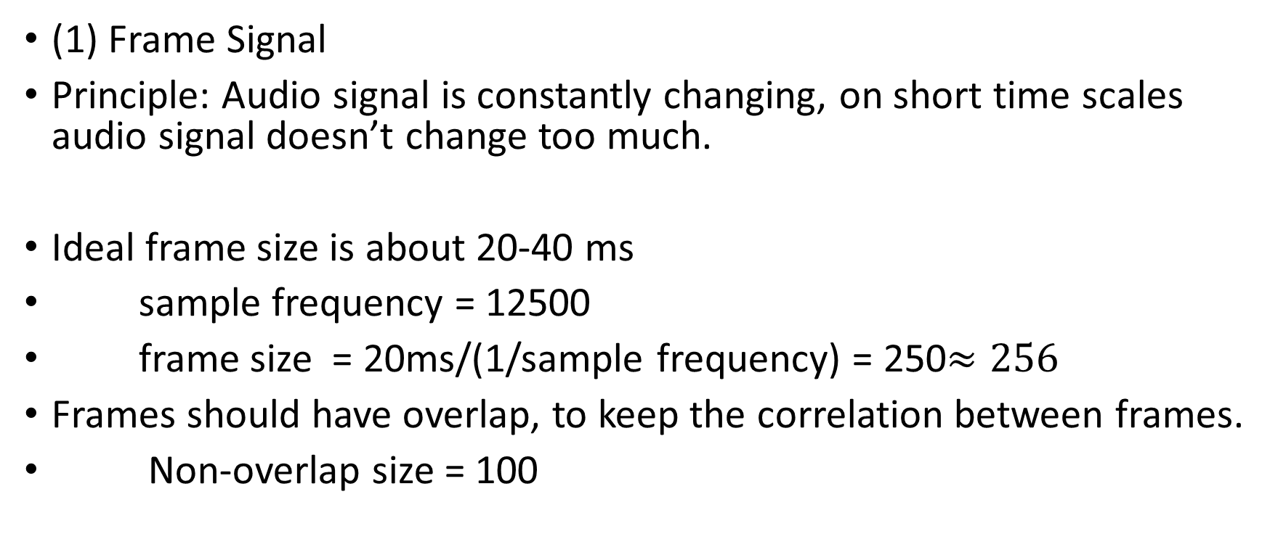
MFCC
(1) Frame Signal
Principle: Audio signal is constantly changing, on short time scales audio signal doesn’t change too much.
Ideal frame size is about 20-40 ms
sample frequency = 12500
frame size = 20ms/(1/sample frequency) = 250$≈256$
Frames should have overlap, to keep the correlation between frames.
Non-overlap size = 100

Slide 5
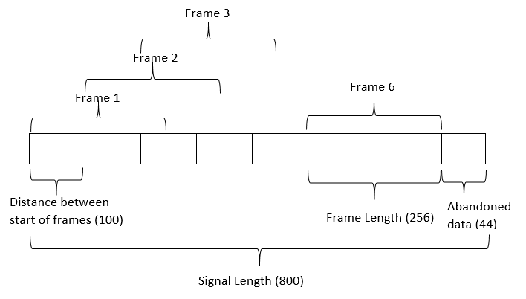

MFCC
(1) Frame Signal
Number of frame (N)
$N=\left\lfloor (L−F)/D\right\rfloor +1$
$=\left\lfloor (800−256)/100\right\rfloor +1$
$=6$

Slide 6
MFCC
Number of Frames (6)
(1) Frame signal
Result :
Frame size x Number of Frames
Matrix
Each column ~ frame raw data
Conclusion : All information preserved.
Data is audio length dependent.
…… …… …… …… …… …… | …… …… …… …… …… …… | …… …… …… …… …… …… | …… …… …… …… …… …… | …… …… …… …… …… …… | …… …… …… …… …… ……
Frame size (256)

Slide 7
MFCC
(2) Estimate power spectrum
Principle : Simulate human cochlea. Cochlea vibrates at different spots depending on the frequency of incoming sound.
Steps:
(a) Apply hamming window to each frame. (Reduce discontinuity)
(b) FFT on each frame, keep the upper half of matrix. (Transfer to frequency domain, remove duplicate information )
(c) Square all matrix element (Got power spectrum)

Slide 8
MFCC
(2) Estimate power spectrum
Result:
(Frame size/2) x Number of Frames matrix
Each column ~ frame power spectrum
Conclusion: Power information is preserved. Phase information lost.
Data is still audio length dependent.

Slide 9
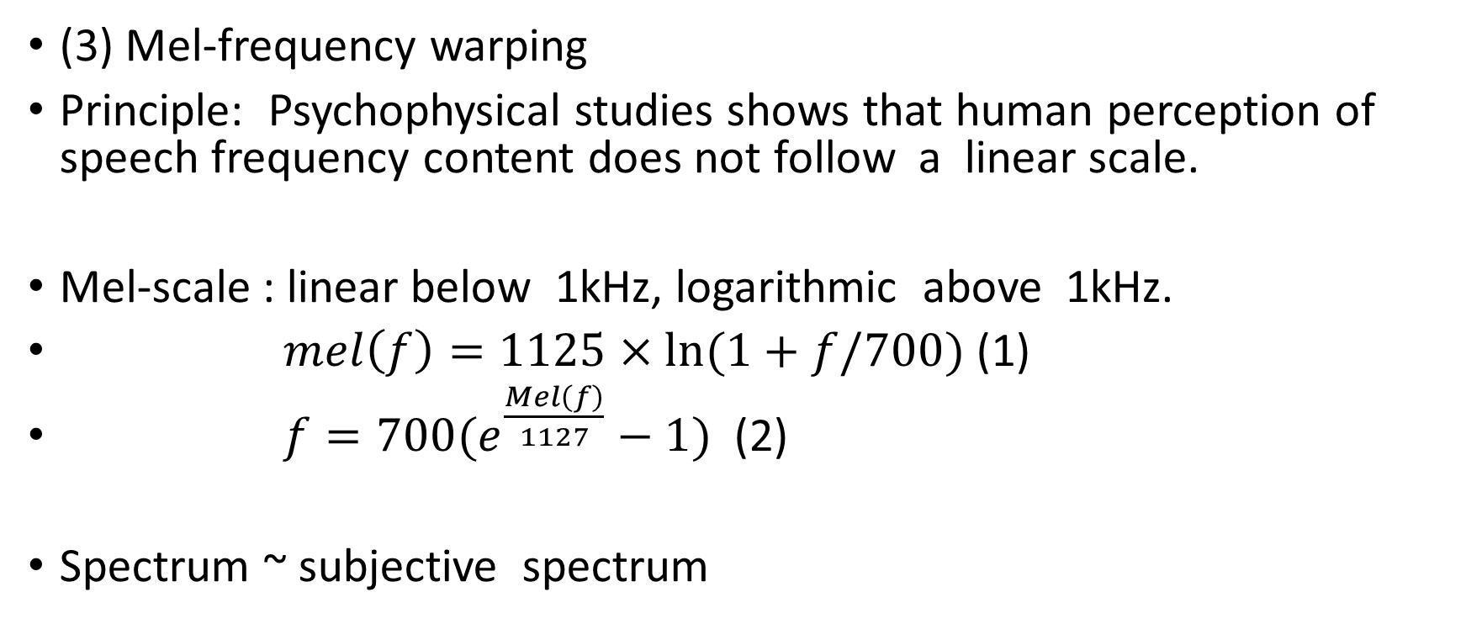
MFCC
(3) Mel-frequency warping
Principle: Psychophysical studies shows that human perception of speech frequency content does not follow a linear scale.
Mel-scale : linear below 1kHz, logarithmic above 1kHz.
$mel\left(f\right)=1125×ln(1+f/700)$ (1)
$f=700(e^{\frac{Mel\left(f\right)}{1127}}−1)$ (2)
Spectrum ~ subjective spectrum

Slide 10
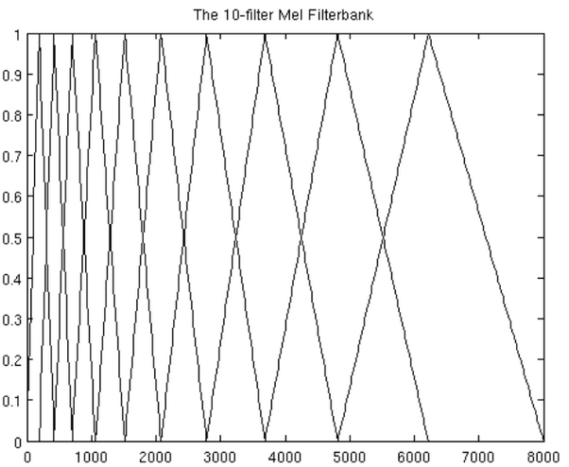
MFCC
(3) Mel-frequency warping
Example of Mel-Filterbank
(i)Mel-Spectrum coefficients:
Number of filters in filterbank
Usually 20 – 30
(ii)Every filter bank contains
Frame Size/2 points

Slide 11
MFCC
(3) Mel-frequency warping
(i) Generate Mel-Filterbank
Example: (a) fs = 12500 => max filter range = 6250
(b) frequency range of Filterbank = [0,6250]
(c) Mel-frequency range of Filterbank = [0,2582]
(d) Choose Mel-spectrum coefficient(M) = 20
Divide range by M+1
Mel-frequency range of first filter =[0,297]

Slide 12
MFCC
(3) Mel-frequency warping
(i) Generate Mel-Filterbank
(e) frequency range of first filter = [0,211].
(f) Generate a 128 points triangular band pass filter
between this range.
(g) repeat step (e) to (f).

Slide 13
MFCC
Result filter bank:
Number of filters x Frame size/2 matrix
Each row ~ one band pass filter
Number of Filters (20)
 |  | Filter 1
Frame size /2 (128)

Slide 14
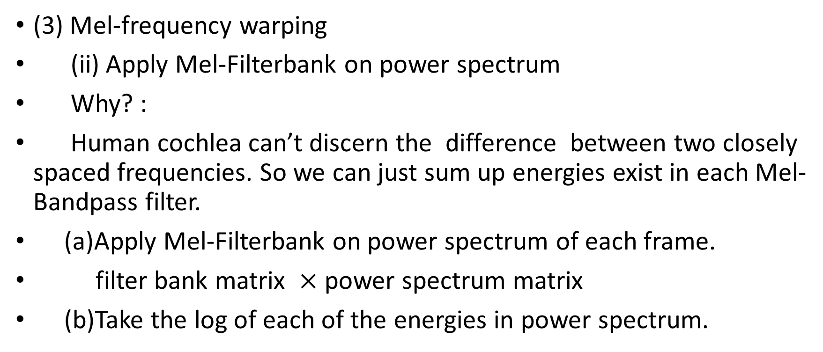
MFCC
(3) Mel-frequency warping
(ii) Apply Mel-Filterbank on power spectrum
Why? :
Human cochlea can’t discern the difference between two closely spaced frequencies. So we can just sum up energies exist in each Mel-Bandpass filter.
(a)Apply Mel-Filterbank on power spectrum of each frame.
filter bank matrix $×$ power spectrum matrix
(b)Take the log of each of the energies in power spectrum.

Slide 15
MFCC
(3) Mel-frequency warping
Result:
(Number of filters) x Number of Frames matrix (Size reduced!)
Each column ~ filtered frame power spectrum
Conclusion: Only information is sensitive to human ear is preserved.
Data is still audio length dependent.

Slide 16

Questions?
Why training and recognition can’t be performed on different device?
Possible Explain: This algorithm can identify devices only when the difference of devices is so big that it can be identified by human ear!
TOSHIBA
Mac

Slide 17
Questions?
What if the difference between devices is not that huge ?
Possible solution?
Look into circuit structure of voice recorder, see what kind of noise is more easy to catch.

Slide 18
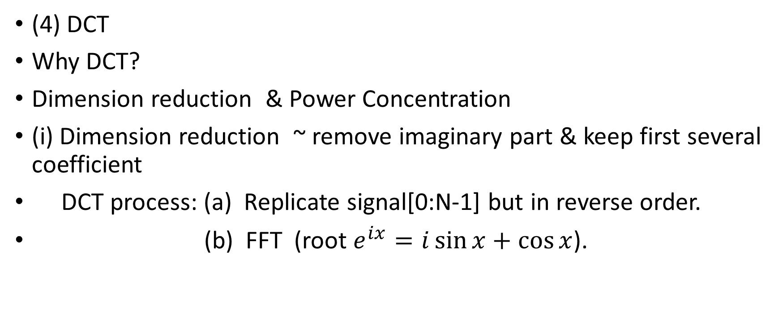
MFCC
(4) DCT
Why DCT?
Dimension reduction & Power Concentration
(i) Dimension reduction ~ remove imaginary part & keep first several coefficient
DCT process: (a) Replicate signal[0:N-1] but in reverse order.
(b) FFT (root $e^{ix}=i\sin{x}+\cos{x}$).

Slide 19
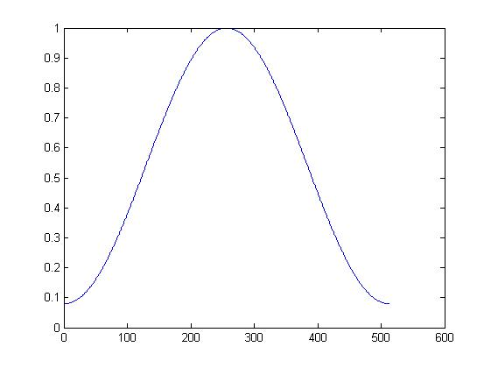
MFCC
(4) DCT
(ii) DCT provide much better power concentration when input signal is not periodic function.
Hamming window is not enough to
eliminate discontinuity completely.
High frequency interference left

Slide 20
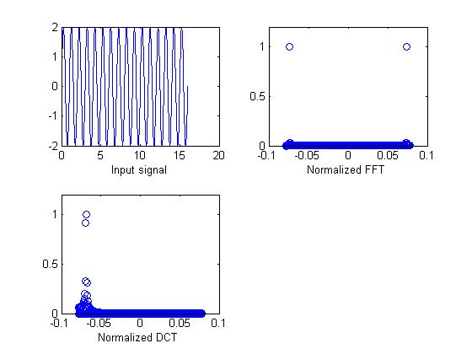
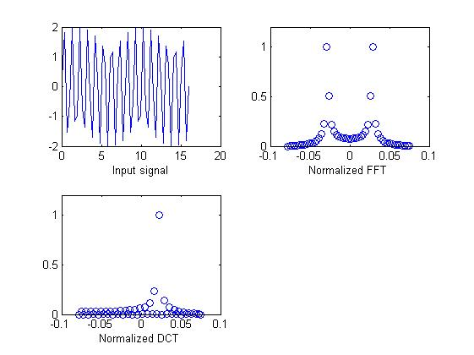
MFCC
(4) DCT
Faster attenuation!

Slide 21
MFCC
(4) DCT
(a) Apply DCT on each frame of filtered energy spectrum
(b) Only first 12-13 coefficients is kept for each spectrum (experience)
Result:
13 x Number of Frames matrix (Size reduced more!)
Conclusion: Data is further compressed.
Data is still audio length dependent.

Slide 22
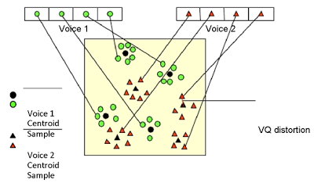
Vector Quantization
Dimension Reduction (clustering)
Principle : It divide large set of vectors into groups having approximately the same number of points closest to them.
2-Dimension example

Slide 23

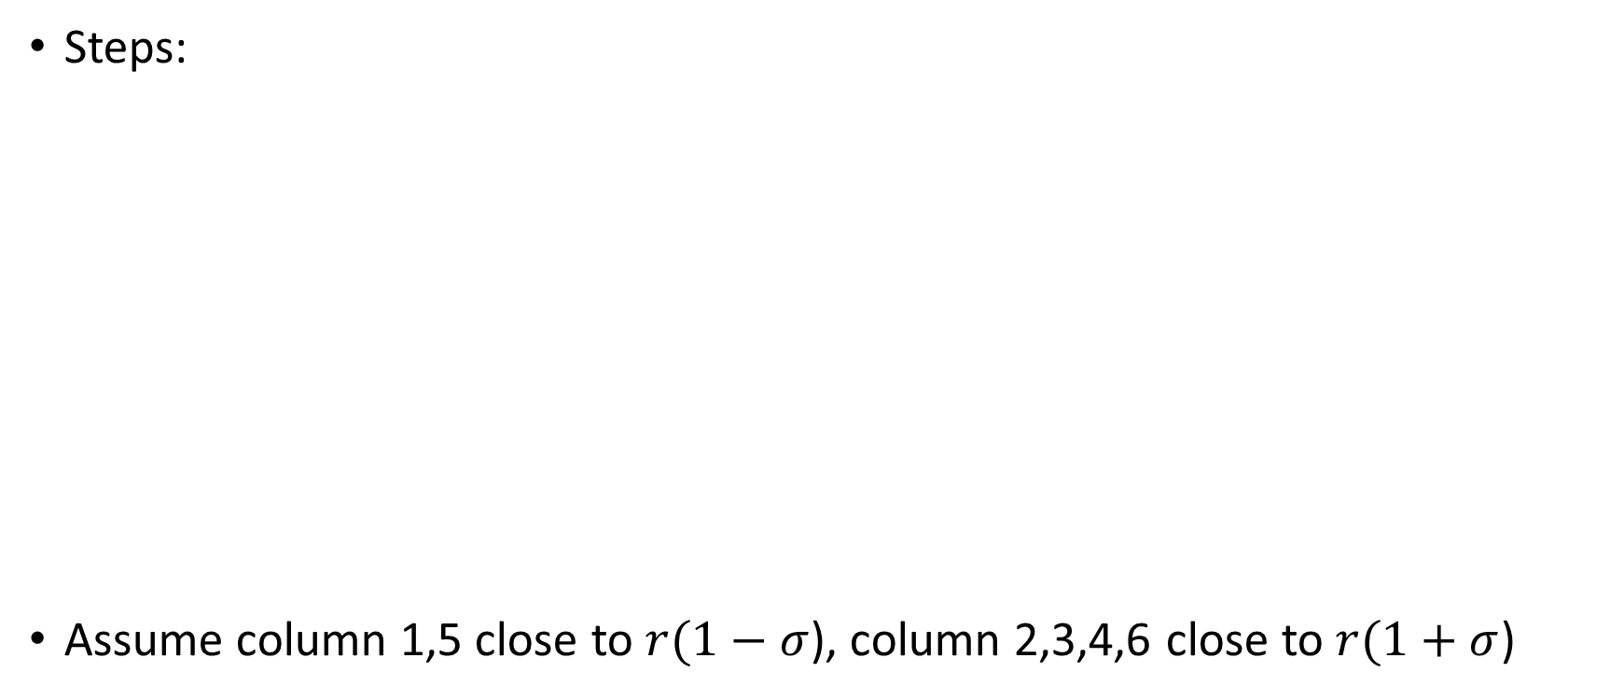



Vector Quantization
Steps:
Assume column 1,5 close to $r(1−σ$), column 2,3,4,6 close to $r(1+σ$)
$$data$$
$$r$$
$r(1−σ$)
$r(1+σ$)
Get mean of each row
13
13
 |  | …….
 |  | ……
frame1 | frame2 | ……
 |  | ……
 |  | ……
13
Number of frames (6)
Step 1
1
Step 2
2
Step 3

Slide 24







Vector Quantization
$${r\left(1−σ\right)}^{′}(1+σ)$$
$${r\left(1−σ\right)}^{′}(1−σ)$$
$${r\left(1+σ\right)}^{′}(1−σ)$$
Steps:
Next : repeat step(4) – step(6).
In our design, we choose to have 16 centroids. Split 4 times.
$${r\left(1+σ\right)}^{′}(1+σ)$$
$$data$$
$${r(1−σ)}^{′}$$
$${r(1+σ)}^{′}$$
13
13
frame1 | frame2 | frame3 | frame4 | frame5 | frame6
13
Number of frames (6)
Step (4)
2
Step (5)
4
Step (6)

Slide 25
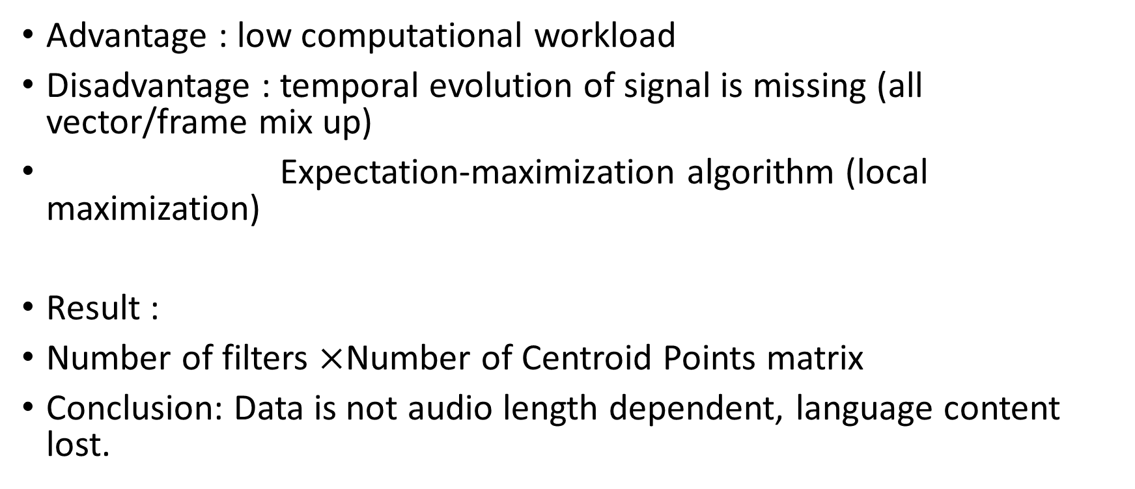
Vector Quantization
Advantage : low computational workload
Disadvantage : temporal evolution of signal is missing (all vector/frame mix up)
Expectation-maximization algorithm (local maximization)
Result :
Number of filters $×$Number of Centroid Points matrix
Conclusion: Data is not audio length dependent, language content lost.

Slide 26
Speaker Recognition
Steps:
(a) Extract MFCC coefficient of target voice.
(b) For each frame, find the closest centroid in VQ codebook(of one person : ‘Mike’).
(c) Sum up the VQ distortion.
(d) Divide distortion summation by number of frames, got the average distortion distance
(e) If the distortion is relatively small, target voice is the voice of Mike.

Slide 27
Other pattern recognition method
Dynamic time warping
Hidden Markov Model

Slide 28
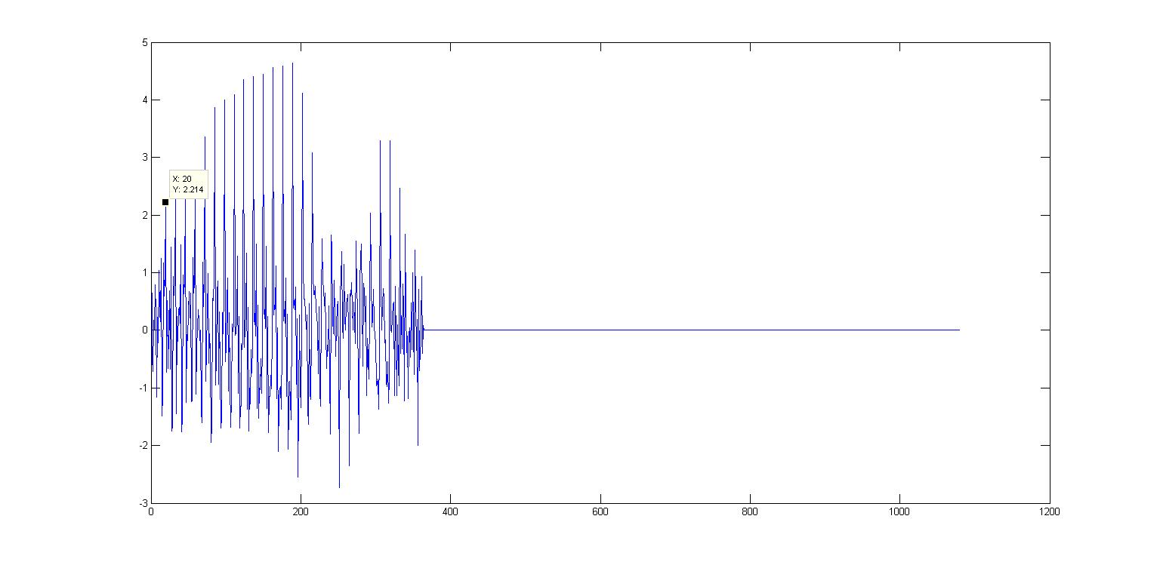
Hidden Markov Model
Signal After MFCC (Number of filters = 13 & Single word ‘food’)

Slide 29

Hidden Markov Model
(33-20)/13 = 1 ~ syllable continue

Slide 30
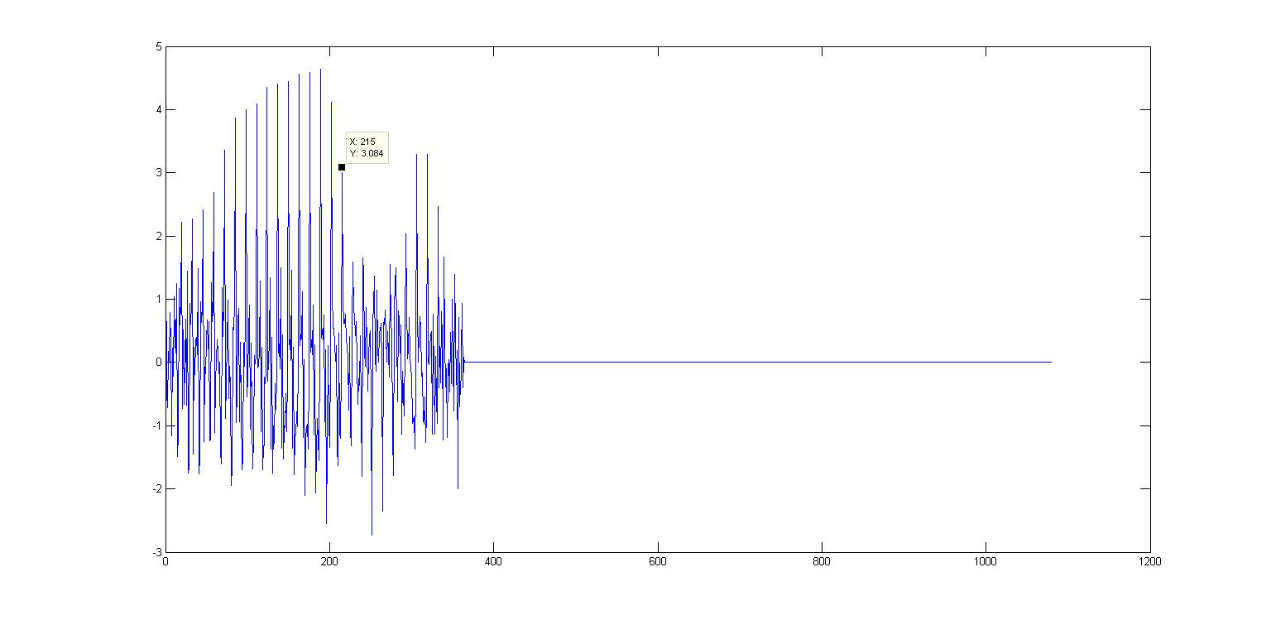
Hidden Markov Model
(215-20)/13 =15 ~ syllable continue

Slide 31
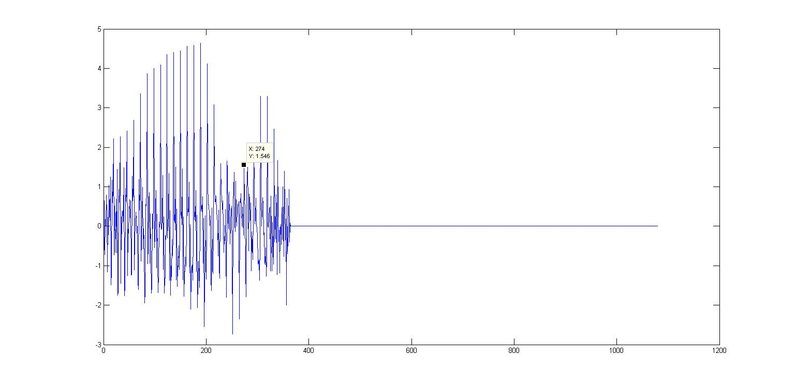
Hidden Markov Model
(274-20)/13 =19.53 ~ new syllable start

Slide 32
Future Plan
Read about Hidden Markov Model
Keep learning about Android App Design
Explore device noise pattern

